Slide 1

Object Detection
Week 6
Brian Spiering

Slide 2
Tuesday Agenda
4:00 - 4:20: Welcome & Review
4:20 - 4:55: Object Detection
4:55 - 5:00: Break
5:00 - 5:55: Project Pitches Practice
5:55 - 6:00: Break
6:00 - 6:50: Stochastic gradient descent (SGD) Optimizers
6:50 - 7:00: Wrap-up & Feedback form

Slide 3
Saturday Morning Agenda
9:00 - 9:25: Welcome & Review
9:25 - 9:55: Semi-supervised Learning
9:55 - 10:00: Break
10:00 - 10:25: Auto-ML
10:25 - 10:55: Live Assignment
10:55 - 11:00: Break
11:00 - 10:25: Zero/One/Few Shot Learning
11:25 - 10:55: ML System Design
12:00 - 12:30: Lunch Break
12:30 - 1:30: Brian assists with Live Coding Assignment

Slide 4
Questions about any previous materials?
Notes:
I read the feedback from last question.
There was of mention of not getting to all the questions.
I’m sorry. That is a mistake in my time management skills.

Slide 5
Review Prompts
One primary advantage of deep learning (DL) relative to traditional machine learning is DL automatically learns the best __________. DL does this through ______________.
Name at least two different non-linear functions that commonly used as activation functions in DL. Name the most currently popular non-linear function. Why is it so popular?
Draw a picture of convolution. Draw another picture of a Convolutional Neural Network (CNN).

Slide 6
Learning Objectives
Describe real-world examples of Object Detection.
Diagram common Object Detection architectures.
Describe common stochastic gradient descent (SGD) optimizers.
Explain common deep learning hyperparameters.
Describe seminal deep neural architecture for applied computer vision tasks.

Slide 7

Object detection
Detect the presence of specific objects in images and videos.
Typically, define a bounding box and a label.
Common examples:
Humans
Faces
Cars
Pedestrian
License plate numbers
House numbers
https://neptune.ai/blog/object-detection-algorithms-and-libraries

Slide 8
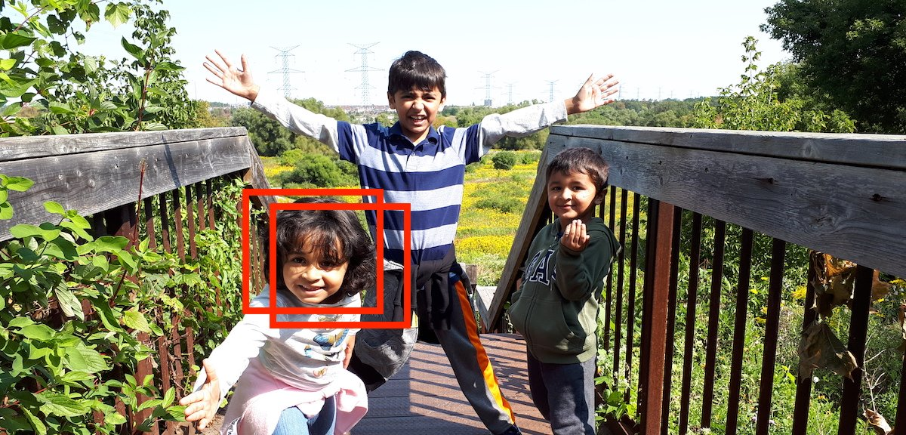
Convolutional Neural Network (CNN)s
are very useful for Object detection
Learn the special and unique properties of each class to identify the required object.
Square shapes have perpendicular corners . A human face has certain properties
A CNN can learn a filter for object specific properties.
https://datalya.com/blog/content/4-machine-learning/7-object-detection-with-sliding-window-algorithm/sliding_window.jpg

Slide 9
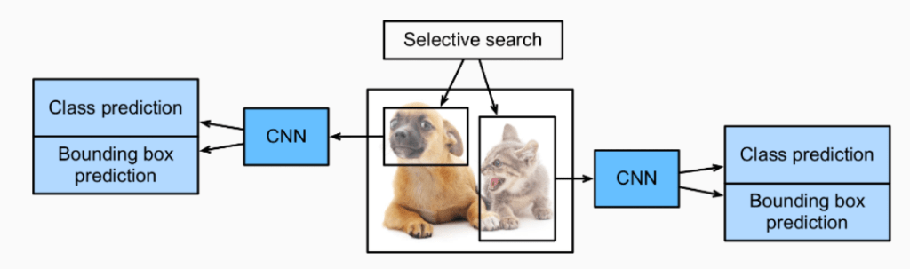
Region-based Convolutional Neural Networks
(R-CNN)
Select the most important regional proposals.
With the regions, find the class prediction and bounding box.
https://neptune.ai/blog/object-detection-algorithms-and-libraries

Slide 10
Two Shot Detection
Detect Segmented Region Proposals first, followed by bounding boxes.
Run time limited by number of regional proposals.
Regional proposals handle class imbalances well. It is a high recall / high precisions stacking design pattern.
Faster R-CNN achieves at most 7 fps (frames per second).

Slide 11
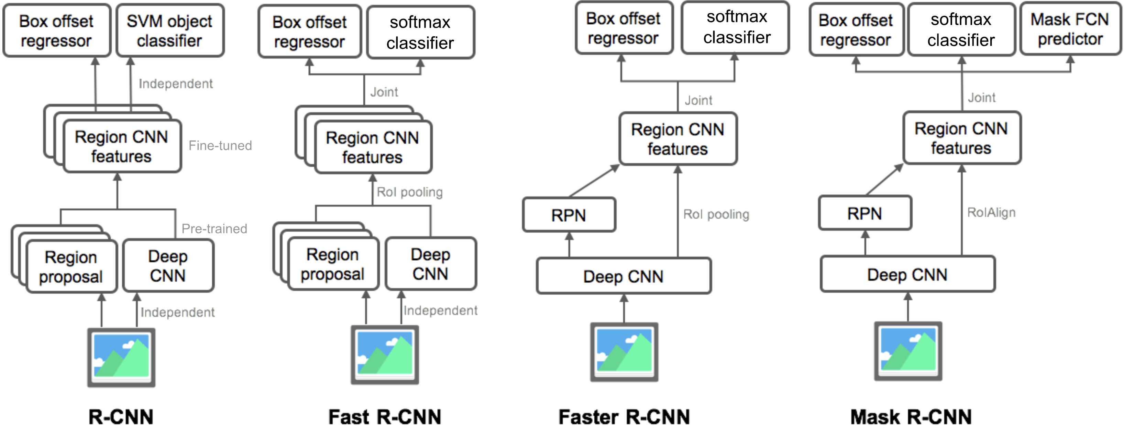
Two shot detectors
Faster R-CNN is parallelized.
Source: https://bit.ly/3hC6ReJ

Slide 12
Single Shot Detection
Detect bounding box for objects directly along with object class probability.
Reduced redundancy as classification and localization are integrated.
Generally inferior performance for rare objects (data imbalance problem, especially for foreground vs background).
However, significantly faster than 2-step detection because there are fewer layers / modules. (Speed vs accuracy trade-off is common across ML)

Slide 13
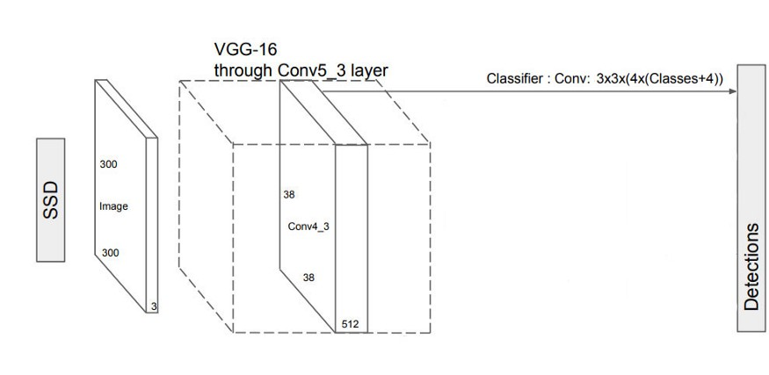
Single Shot Detector (SSD) Network
# classes = 20+1 (none)
Source: https://bit.ly/3hC6ReJ

Slide 14
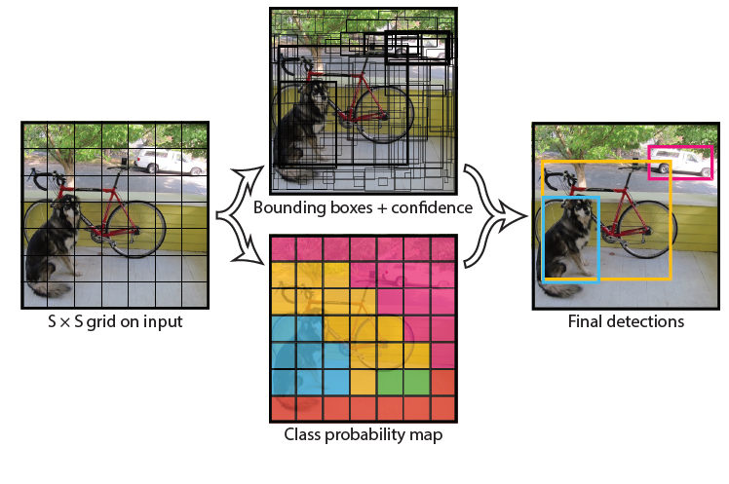
YOLO: You Only Look Once v1
No bounding box proposals.
Image is divided to grid structure
Model predicts a class and a box for every location in image grid.

Slide 15
Single shot detectors
SSD
Runs a convolutional network on input image one time and computes feature map.
Run a small 3×3 sized convolutional kernel on this feature map to foresee the bounding boxes and categorization probability.
SSD uses anchor boxes at a variety of aspect ratio (4) and learns off-set to each box at multi-scale
Confidence and localization loss.
More practical due to speed on videos.
YOLO
Divides every image into a grid of S x S and every grid predicts N bounding boxes and confidence.
Forecasts the classification score for every box for each class.
SxSxN boxes are forecasted. Most are triaged after 0.3 threshold.
Confidence localization and classification loss
More popular due to open source implementation. Darknet.
Several changes to network in YOLO v4, with changes in network and detector training processes.
https://syncedreview.com/2020/04/27/yolo-is-back-version-4-boasts-improved-speed-and-accuracy/

Slide 16
Questions?

Slide 17
5-minute break!
What should you do during the break?
Turn off your video & microphone
Get up! Move your body!
Try to not look at your phone or other websites. It should be a screen and information break so you are ready to focus on the next section.
Notes:
Remember to mute it

Slide 18
Tuesday Agenda
4:00 - 4:20: Welcome & Review
4:20 - 4:55: Object Detection
4:55 - 5:00: Break
5:00 - 5:55: Project Pitches & Capstone Selection
5:55 - 6:00: Break
6:00 - 6:50: Stochastic gradient descent (SGD) Optimizers
6:50 - 7:00: Wrap-up & Feedback form

Slide 19
Saturday Morning Agenda
9:00 - 9:25: Welcome & Review
9:25 - 9:55: Semi-supervised Learning
9:55 - 10:00: Break
10:00 - 10:25: Auto-ML
10:25 - 10:55: Live Assignment
10:55 - 11:00: Break
11:00 - 10:25: Zero/One/Few Shot Learning
11:25 - 10:55: ML System Design
12:00 - 12:30: Lunch Break
12:30 - 1:30: Brian assists with Live Coding Assignment

Slide 20
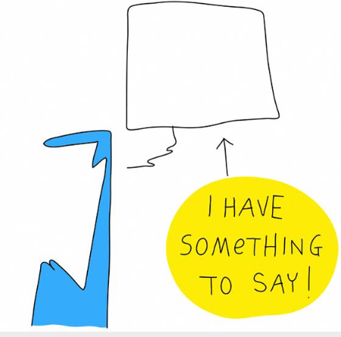
Presentation Advice
Presentation = Content + Design + Delivery
Provide specific examples. Concrete implementation of abstract idea.
Slides are not a teleprompter
Images > words
Word Budget - Each word costs exponential more
Rehearse but do no memorize entire presentation.
Memorize intro & outro.

Slide 21


Project Pitches Practice
Each person gets 5 minutes to present (without interruption).
1 minute for questions and answers.
3 minutes for feedback on project ideas.
Come back to main room after everyone in a breakroom presents.

Slide 22
5-minute break!
What should you do during the break?
Turn off your video & microphone
Get up! Move your body!
Try to not look at your phone or other websites. It should be a screen and information break so you are ready to focus on the next section.
Notes:
Remember to mute it

Slide 23
Tuesday Agenda
4:00 - 4:20: Welcome & Review
4:20 - 4:55: Object Detection
4:55 - 5:00: Break
5:00 - 5:55: Project Pitches & Capstone Selection
5:55 - 6:00: Break
6:00 - 6:50: Stochastic gradient descent (SGD) Optimizers
6:50 - 7:00: Wrap-up & Feedback form

Slide 24
Saturday Morning Agenda
9:00 - 9:25: Welcome & Review
9:25 - 9:55: Semi-supervised Learning
9:55 - 10:00: Break
10:00 - 10:25: Auto-ML
10:25 - 10:55: Live Assignment
10:55 - 11:00: Break
11:00 - 10:25: Zero/One/Few Shot Learning
11:25 - 10:55: ML System Design
12:00 - 12:30: Lunch Break
12:30 - 1:30: Brian assists with Live Coding Assignment

Slide 25
Optimization
Generally - Find the best solution to a given problem.
Mathematically - Finding the optimal value for a function.
Twin Pillars of Optimization
Effective - Find the best.
Efficient - Find it quickly.
In DL, the goal is to find a pretty good set of parameters as quickly as possible. Since DL is an empirical field, we can never be sure the best (aka, global minimum)
Notes:
Nesterov accelerated gradient(NAG)
Adagrad — Adaptive Gradient Algorithm
Adadelta
RMSProp
Adam — Adaptive Moment Estimation

Slide 26
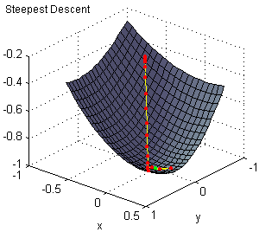
Error Surfaces
Notes:
Nesterov accelerated gradient(NAG)
Adagrad — Adaptive Gradient Algorithm
Adadelta
RMSProp
Adam — Adaptive Moment Estimation

Slide 27
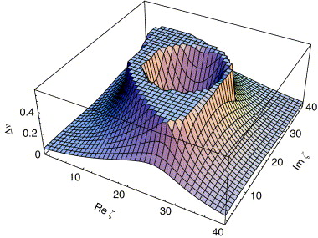
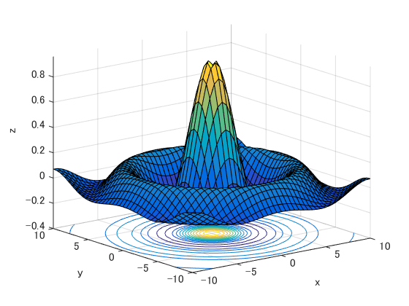
Error Surfaces can be tricky
Notes:
Nesterov accelerated gradient(NAG)
Adagrad — Adaptive Gradient Algorithm
Adadelta
RMSProp
Adam — Adaptive Moment Estimation

Slide 28
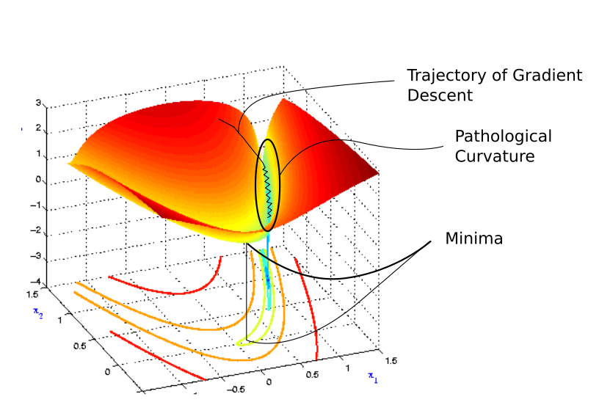
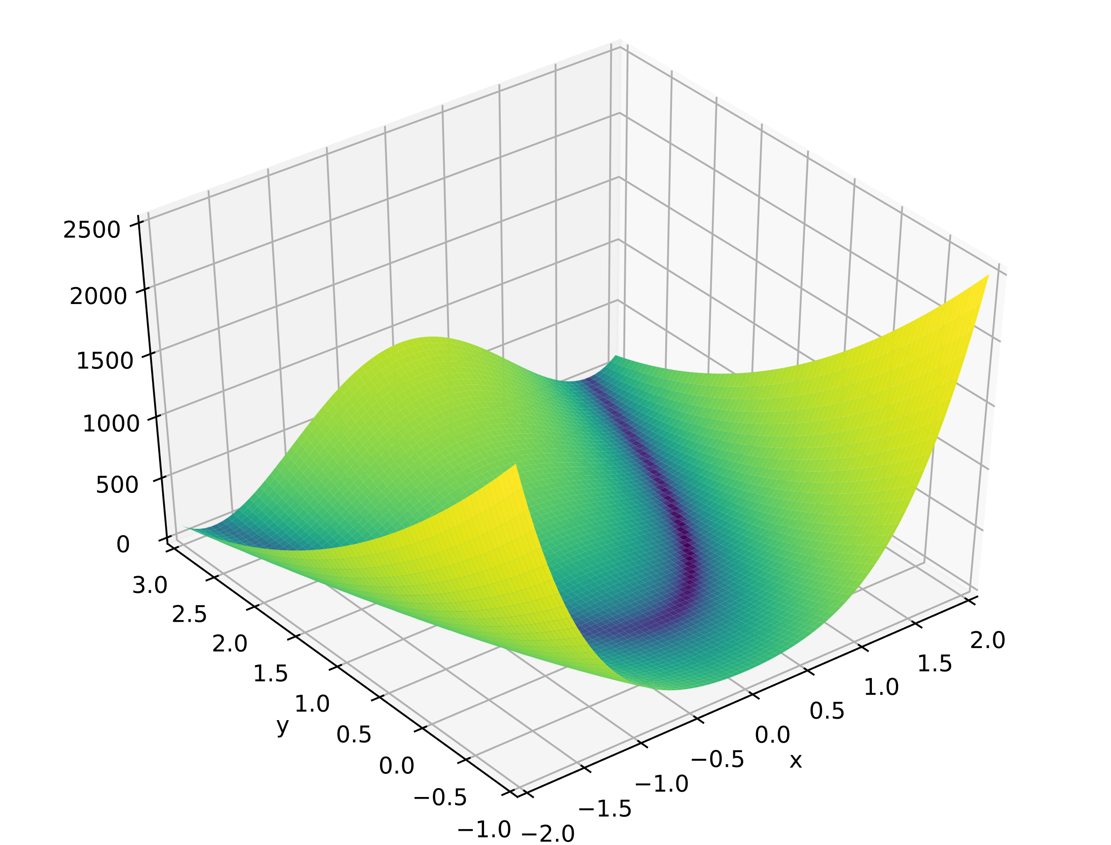
Error Surfaces can be tricky
Notes:
Nesterov accelerated gradient(NAG)
Adagrad — Adaptive Gradient Algorithm
Adadelta
RMSProp
Adam — Adaptive Moment Estimation

Slide 29
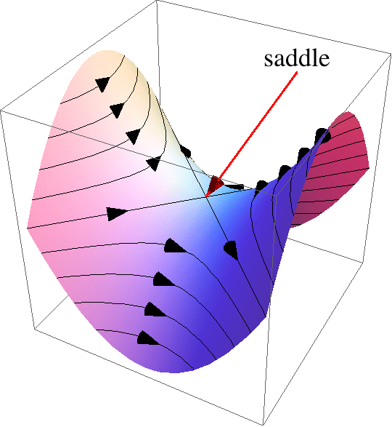
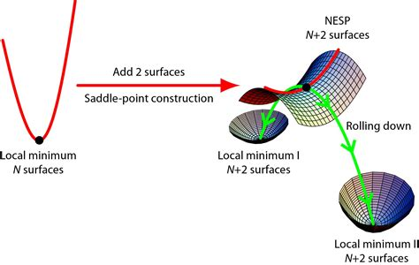
Saddle point
Occur at a relative minimum along one axial direction (between peaks), where the crossing axis is a relative maximum.
The derivative is zero (in at least one direction) but not a local optimal.
Can pose a problem for some gradient-based optimization methods.
Notes:
Nesterov accelerated gradient(NAG)
Adagrad — Adaptive Gradient Algorithm
Adadelta
RMSProp
Adam — Adaptive Moment Estimation

Slide 30
Optimizers
Optimizers update the weight parameters to minimize the loss function while performing Gradient Descent.
Adaptive Optimizers update the behavior of the optimizer based on history of the optimizer.
How steep is the current gradient relative to previous gradient?

Slide 31
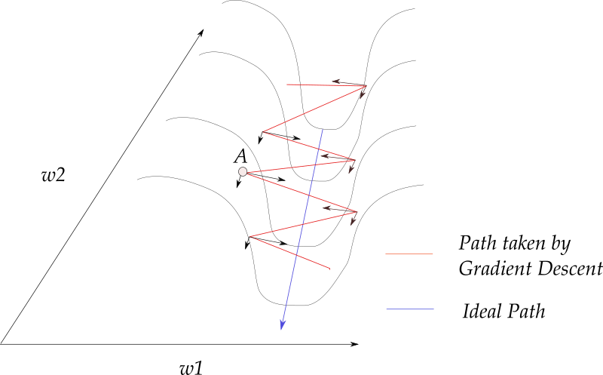
Adaptive Optimizers
Goal: To modify the learning step based on the topology of the contours.
https://blog.paperspace.com/intro-to-optimization-momentum-rmsprop-adam/#:~:text=prone%20to%20overshooting)-,Adam,of%20both%20Momentum%20and%20RMSProp.

Slide 32
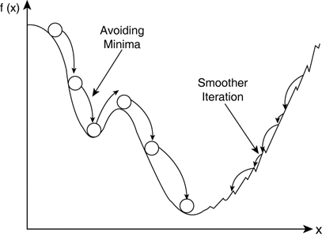
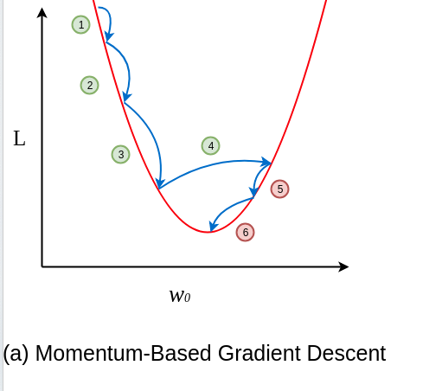
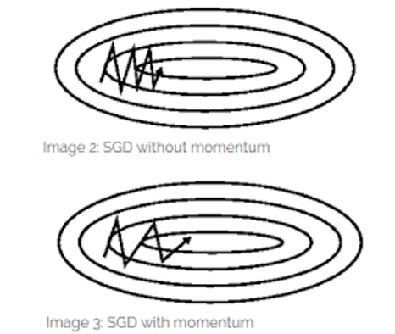
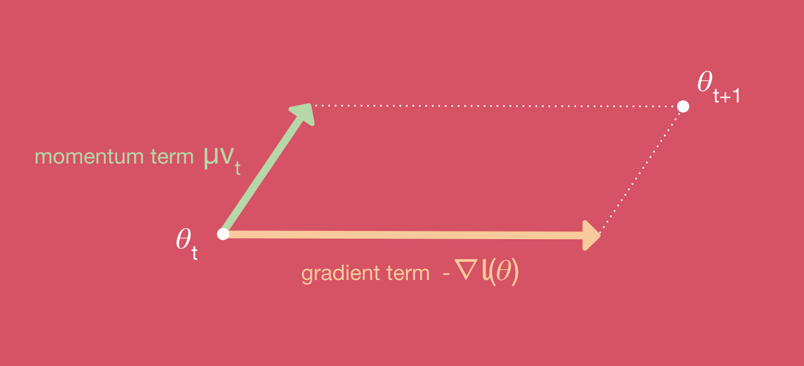
Momentum SGD
Accelerates search in direction of minima by accumulating gradients of past steps
https://blog.paperspace.com/intro-to-optimization-momentum-rmsprop-adam/#:~:text=prone%20to%20overshooting)-,Adam,of%20both%20Momentum%20and%20RMSProp.

Slide 33
Adaptive Optimizers
RMSprop:
Impedes search in the direction of oscillations based on avg. of gradient squared.
Chooses different learning rate for each parameter.
Adam:
Combines Momentum and RMSprop

Slide 34
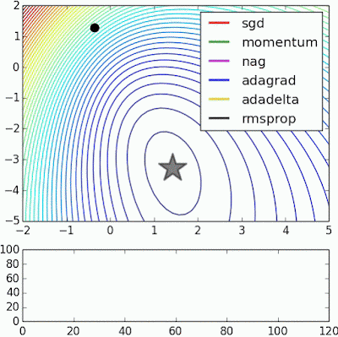
Adaptive Optimizers Behavior
https://medium.com/datadriveninvestor/overview-of-different-optimizers-for-neural-networks-e0ed119440c3
Notes:
Nesterov accelerated gradient(NAG)
Adagrad — Adaptive Gradient Algorithm
Adadelta
RMSProp
Adam — Adaptive Moment Estimation

Slide 35

Adaptive Optimizers Behavior
https://medium.com/datadriveninvestor/overview-of-different-optimizers-for-neural-networks-e0ed119440c3
Notes:
Nesterov accelerated gradient(NAG)
Adagrad — Adaptive Gradient Algorithm
Adadelta
RMSProp
Adam — Adaptive Moment Estimation

Slide 36

Adaptive Optimizers Behavior
https://medium.com/datadriveninvestor/overview-of-different-optimizers-for-neural-networks-e0ed119440c3
Notes:
Nesterov accelerated gradient(NAG)
Adagrad — Adaptive Gradient Algorithm
Adadelta
RMSProp
Adam — Adaptive Moment Estimation

Slide 37
Optimizers Activity

Slide 38
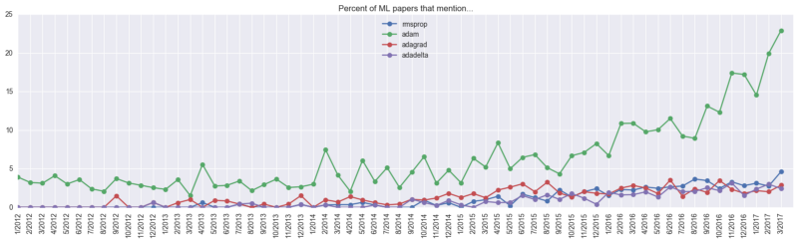

Which Adaptive Optimizer to pick?
It doesn't matter for too much for applied problems, just pick a decent optimizer. Architectures, data, and training epochs are more important.
Empirical question: If you have time, find out.
Show me the metadata:
Notes:
This is one of the reasons why I don’t read individual machine learning papers. Trends in the field are important, individual work is too noisy.

Slide 39
If you want a clear mathematical explanation: https://ruder.io/optimizing-gradient-descent/

Slide 40
Extra slides

Slide 41
Live Assignment: Machine Learning Engineer @ Apple Cameras (Access your existing codebooks)

Slide 42


Overall System Design: End-to-end Process
Predictive Data Model using few training samples and pre-trained network
You are here
Data Processing (Cleaning, formatting)
Model Assessment and Feedback
Past data (Trained network weights)
New Data Creation

Slide 43
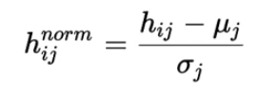
Batch Norm
Batch normalization is done individually at each hidden neuron in the network.
normalize the activation values such that the hidden representation doesn’t vary drastically and also helps us to get improvement in the training speed.

